Slide 1
Agenda - UTF-8 Data Cleanup
Overview of Character Sets
Developing a Business Process for Sharing Global Data
Overview of Oracle Tools for Global Data

Slide 2
Overview of Character Sets
What is a Character Set?
A character set defines a collection of characters, numbers, punctuation, symbols, and special characters for a particular language.
  character data must be stored as binary digits
  individual characters must be assigned unique values
  character set that has assigned values for each character is called a coded character set or code set
  hardware, software, and operating systems can then exchange information for a particular language or for a collection of languages using these code points.

Slide 3
Overview of Character Sets
ASCII
The most common Character Set is the American Standard Code for Information Interchange.
  7-bit character set ( Code Points 0 to 127 )
  only guaranteed way of exchanging electronic information until Unicode
  ASCII contains the following characters:
    Control Characters ( NUL, BEL,CR,etc.)
    Upper and Lower Case English Letters ( A – Z and a – z )
    Numbers ( 0 –9 )
    Punctuation and other symbols (!@#$%^&*()=,-+<>_)

Slide 4
Overview of Character Sets
ANSI
American National Standards Institute (ANSI) code page is a generic term used to describe a collection of code pages used for character encoding in Windows applications.
  ASCII Character Set could not support different languages
  support ASCII for the first 128 characters
  replaced extended graphics characters with much-needed characters and symbols.
  several variants were created to handle localized versions of Windows for a total of eight Windows ANSI code pages

Slide 5
Overview of Character Sets
ISO 8859
International Standards Organization (ISO) created a series of character sets to accommodate a much larger selection of languages than ASCII.
  8-bit character set ( max characters 256, 0 thru 255)
  support ASCII for the first 128 characters
  96 additional code points to support characters required for language support.
  15 character sets to support grouping of several languages

Slide 6
Overview of Character Sets
UNICODE (UCS)
Unicode Consortium designed this encoding scheme to solve some of the most complex problems that occur in developing international applications.
  fixed width 16-bit character set to represent all characters
  support ASCII , ANSI and additional character sets via translations
  characters from all of the worlds major scripts are included
  popular character set for internet applications
  not compatible with many current applications and protocols

Slide 7
Overview of Character Sets
UTF-8
X/Open Joint Internationalization Group had the objective to specify a File System Safe UCS Transformation Format compatible with UNIX systems, supporting multilingual text. UTF-8 provides compatibility with file systems, parsers and other software that rely on US-ASCII values but are transparent to other values.
  multi-byte 8-bit character set to represent all characters
  preserves full US-ASCII range
  characters from all of the worlds major scripts are included with room for additions
  round trip conversion is easy between UTF-8 and UCS

Slide 8
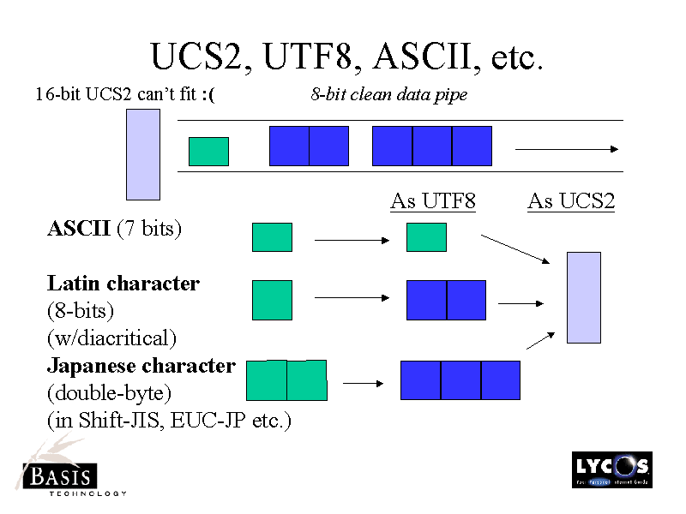
Overview of Character Sets

Slide 9
Overview of Character Sets
Convert from Decimal to Binary
divide repeatedly by 2, using "remainders" rather than decimal places, until you get down to 1.
For example, convert decimal 195 to binary:
  195/2 = 97 r 1
  97/2 = 48 r 1
  48/2 = 24 r 0
  24/2 = 12 r 0
  12/2 = 6 r 0
  6/2 = 3 r 0
  3/2 = 1 r 1
  1/2 = 0 r 1
Now read the remainders from bottom to top: the binary equivalent is 1100 0011

Slide 10
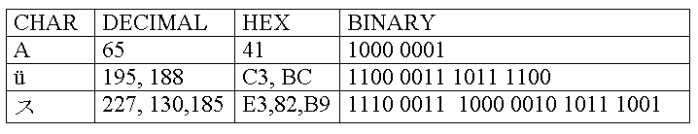
Overview of Character Sets
UTF-8 Examples of Single and Multi-byte Characters

Slide 11
Developing a Business Process for Sharing Global Data
Evaluate Pre-existing Data in the Database
Standardize Internal Systems
Educate Users About the Implications of Sharing Global Data
Communicate with Trading Partners about Data Requirements
Verify Character Set Compliance Prior to Manipulating Data
Understand the Tools
Double Check

Slide 12
Developing a Business Process for Sharing Global Data
Evaluate Pre-existing Data in the Database
  What is the extent of Data Corruption
  What are the sources of the Corrupt Data
  What are the Data Access Points

Slide 13
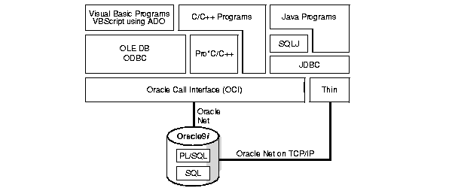
Developing a Business Process for Sharing Global Data
Oracle Data Access Points

Slide 14
Developing a Business Process for Sharing Global Data
Standardize Internal Systems
  If at all possible Standardize Character Sets for All Internal Applications
  This will prevent the need to have conversion routines to support data transfers

Slide 15
Developing a Business Process for Sharing Global Data
Educate Users About the Implications of Sharing Global Data
  Users submitting data MUST accurately specify the character set the data was created in
  Developers MUST be familiar with the behavior of the tools they use
  Developers creating interfaces MUST know the character sets of the Source and Target Applications

Slide 16
Developing a Business Process for Sharing Global Data
Communicate with Trading Partners about Data Requirements
  Data sent by Trading Partners MUST be UTF8 or convertible to UTF8
  Trading Partners MUST inform you of the character set their data was created in
  If the data is not already UTF8 you MUST develop a pre-processing conversion routine

Slide 17
Developing a Business Process for Sharing Global Data
Verify Character Set Compliance Prior to Manipulating Data
  Determine Data Sources you can trust
    These May not require any verification
  For all Data Sources you can not trust, you MUST determine acceptable verification points
    Pre-Processing validation of character sets
    Staging table validation of character sets
    Post Processing validation of character sets

Slide 18
Developing a Business Process for Sharing Global Data
Understand the Tools
  Some Tools Deal explicitly with character set conversion
  Some Do Not
  You MUST understand the Tools used in your data flow and keep current with any “enhancements” in New Releases

Slide 19
Developing a Business Process for Sharing Global Data
Double Check
  Even though you have taken great care to ensure processes are in place, you can not safe guard 100% of the data access points
  You MUST check your data by running Oracle’s Character Set Scanner
    The Source of all Data Corruption MUST identified
    Processes need to be invented/improved to address these new sources
    Steps MUST be taken to clean-up the corrupt data

Slide 20
Oracle Tools for Global Data
Character Set Scanner Utility(csscan)
The Scanner checks all character data in the database and tests for the effects and problems of changing the character set encoding.
Scanner provides an assessment of the feasibility and potential issues in migrating an Oracle database to a new database character set.
Scanner reads and tests for data in CHAR, VARCHAR2, LONG, CLOB, NCHAR, NVARCHAR2, and NCLOB columns only
All the character-based data in CHAR, VARCHAR2, LONG, and CLOB columns must be stored in the same character set
Should be run on a routine basis to identify data corruption issues
See Documentation Oracle9i Database Globalization Support Guide Release 2 (9.2) Part Number A96529-01

Slide 21
Oracle Tools for Global Data
Character Set Scanner Utility(csscan)
Before Using the Character Set Scanner
Run the csminst.sql script on the database that you plan to scan. The script performs the following tasks to prepare the database for scanning:
  Creates a user named CSMIG
  Assigns the necessary privileges to CSMIG
  Assigns the default tablespace to CSMIG
  Connects as CSMIG
  Creates the Character Set Scanner system tables under CSMIG

Slide 22
Oracle Tools for Global Data
Character Set Scanner Utility(csscan)
Create a Parameter File with following information
  USERID=system/password
  FULL=y
  TOCHAR=UTF8
  ARRAY=102400
  PROCESS=32
  FEEDBACK=10000
  LOG=SCAN
  FROMCHAR=UTF8

Slide 23
Oracle Tools for Global Data
Character Set Scanner Utility(csscan)
Execute the Scanner
  $ORACLE_HOME/bin/csscan parfile=csscan.parm >SCAN.out 2>csscan_error.log

Slide 24
Oracle Tools for Global Data
Character Set Scanner Utility(csscan)
Display Output
  SCAN.txt Database scan Summary Report
  SCAN.out Run time output from Scanner
  SCAN Database Scan Individual Except Report
  csscan_error.log Standard Output from Database Scan
  Scanner Error Count Email

Slide 25
Oracle Tools for Global Data
SQL CONVERT Function
CONVERT converts a character string from one character set to another.
Syntax
CONVERT ( char , dest_char_set , source_char_set)
  The char argument is the value to be converted.
  The dest_char_setargument is the name of the character set to which char is converted.
  The source_char_set argument is the name of the character set in which char is stored in the database. The default value is the database character set.
  Does NOT Validate that the conversion is successful.

Slide 26
Oracle Tools for Global Data
SQL CONVERT Function
Example
SELECT CONVERT(’Groß’, ’US7ASCII’, ’UTF8’) "Conversion"
FROM DUAL;
Conversion
----------
Gross
Common character sets include:
  US7ASCII: US 7-bit ASCII character set
  WE8MSWIN1252: West European Microsoft Windows character set
  JA16SJIS: Japanese Shift-JIS 16-bit Multi-Byte character set
  WE8ISO8859P1: ISO 8859-1 West European 8-bit character set
  UTF8: Unicode Transformation Format 8-bit Multi-Byte character set

Slide 27
Oracle Tools for Global Data
SQL DUMP Function
DUMP returns a VARCHAR2 value containing the datatype code, length in bytes, and internal representation of expr. The returned result is always in the database character set.
Syntax
DUMP ( expr, return_fmt, start_position, length)
  The expr argument is the literal to be dumped.
  The return_fmt argument specifies the format of the return value
  The arguments start_position and length combine to determine which portion of the internal representation to return. The default is to return the entire internal representation in decimal notation.

Slide 28
Oracle Tools for Global Data
SQL DUMP Function
Example
SELECT DUMP(’Groß’, 1010)
FROM DUAL;
Typ=96 Len=5 CharacterSet=UTF8: 71,114,111,195,159
  Type 96 indicates the expr is char format
  Length is the length of the expr in bytes
  Characcter Set is of the Database , not necessarily the Data
  71 is the letter G
  114 is the letter r
  111 is the letter o
  195 , 159 is the letter ß

Slide 29
Oracle Tools for Global Data
iSQL*Plus
iSQL*Plus as a light weight, web enabled version of SQL*Plus that is helpful in displaying multi-byte characters that are not displayable on the OS of the client.
  See Note:185707.1 on Metalink for details on how to install and configure iSQL*Plus

Slide 30
Oracle Tools for Global Data
Oracle Applications File Character Set Conversion (adncnv)
The File CharacterSet Conversion is used to convert files from one character set to another.
  required for any text files shipped by Applications, including SQL*Plus scripts, PL/SQL scripts, loader files, driver files, ODF files, header files, and HTML files.
  used to convert data files before using SQL*Loader to load data into the database
  can only convert one file at a time

Slide 31
Oracle Tools for Global Data
Oracle Applications File Character Set Conversion (adncnv)
For UNIX users:
adncnv <source file> <source char set> <destination file> <dest char set>
  The source and destination file names and/or file paths should not be the same.
  Spool the results to a log file. This will make it easier to identify all of the exceptions.
  This Step MUST be included in all Inbound Interfaces. Any file with “Lossy conversion detected for multi-byte character sets” MUST NOT be loaded.

Slide 32
Unix Tools for Global Data
Unix File Character Set Conversion (iconv)
The iconv utility converts the characters or sequences of characters in file from one code set to another and writes the results to standard output. If no conversion exists for a particular character, it is converted to the underscore _ in the target code set.

